Slide 1
Convective Wx Simulations with the WRF Model
Chris Herbster
Natalie Gusack
Fred Mosher
Mike Masscotte
ERAU Applied Meteorology
Daytona Beach, FL

Slide 2
Update on Hot Lake Simulations
Simulations for the Atlanta region were conducted
Multiple temperatures were tested
6 km model resolution
Convection was generated over desired location
Simulation for the NY region
Conducted for day with fair weather / high pressure
Convection was generated but, as expected had limited vertical development
Confirms anticipated limitations to current hot-surface forced convection method

Slide 3
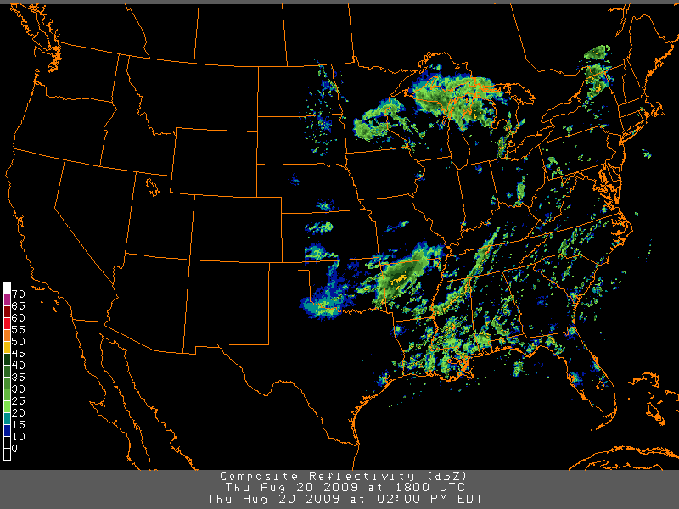
October 20, 2009 - Observed

Slide 4
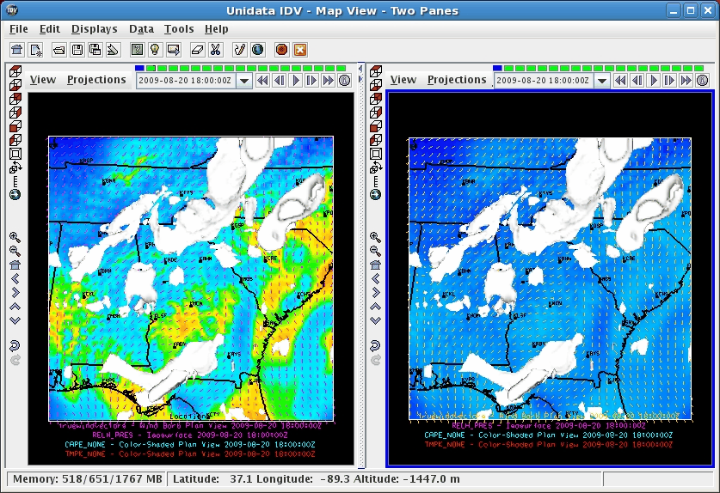
ATL – Control and 335K (~144F)
Control run (left) Hot Lake (right)

Slide 5
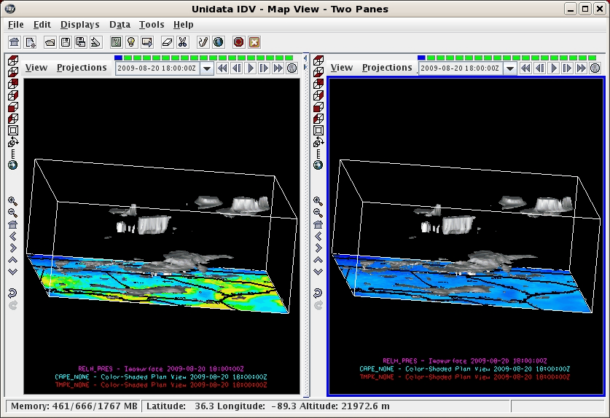
ATL – Control and 335K (~144F)
Control run (left) Hot Lake (right)

Slide 6
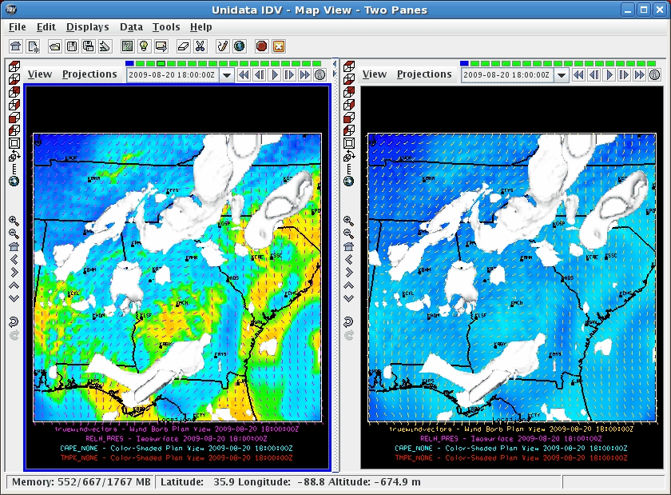
ATL – Control and 325K (~125F)
Control run (left) Hot Lake (right)

Slide 7
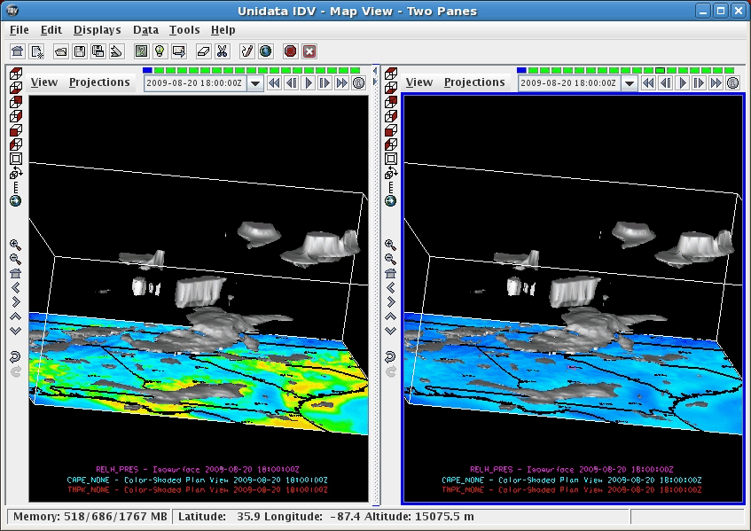
ATL – Control and 325K (~125F)
Control run (left) Hot Lake (right)

Slide 8
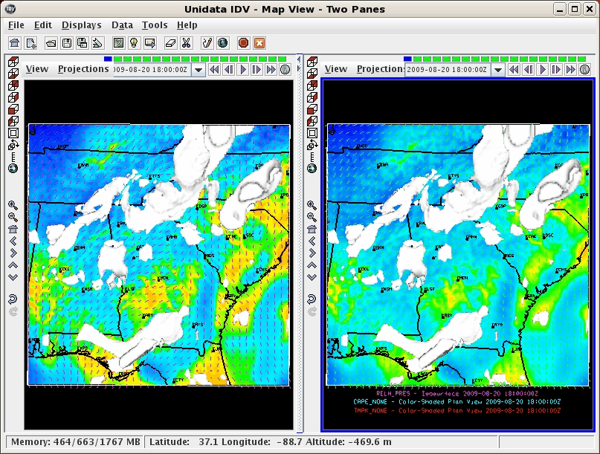
ATL – Control and 315K (~108F)
Control run (left) Hot Lake (right)

Slide 9
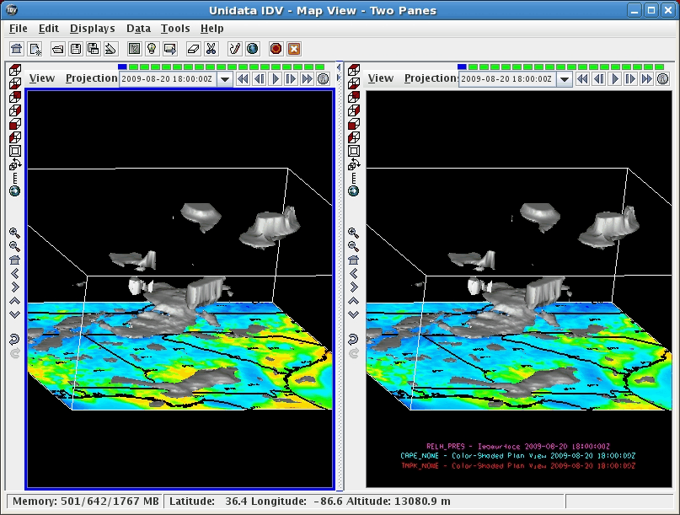
ATL – Control and 315K (~108F)
Control run (left) Hot Lake (right)

Slide 10
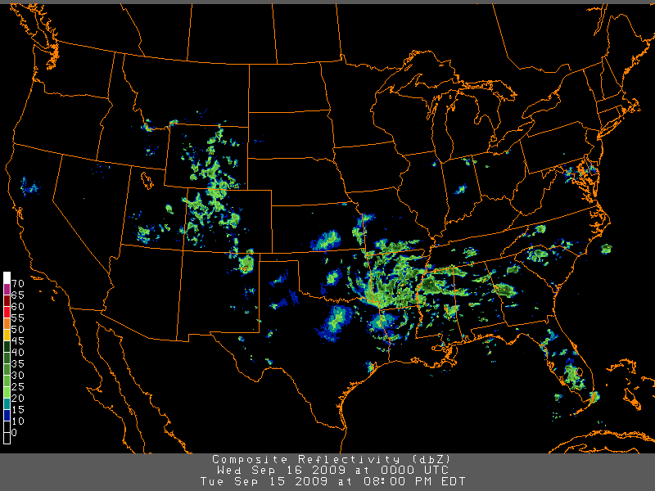
September 15, 2009 - Observed

Slide 11
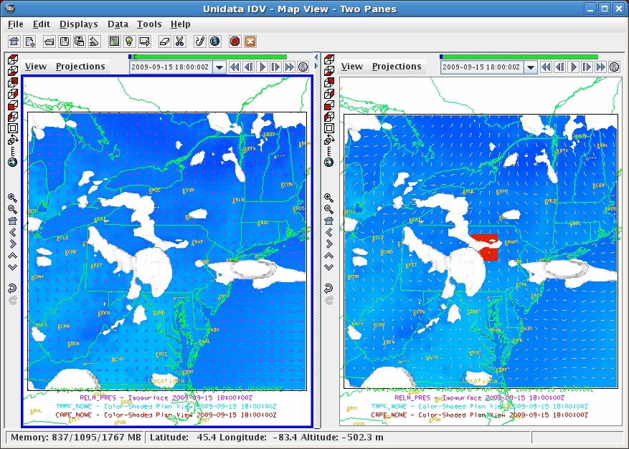
NY – Control and 335K (~144F)
Control run (left) Hot Lake (right)

Slide 12
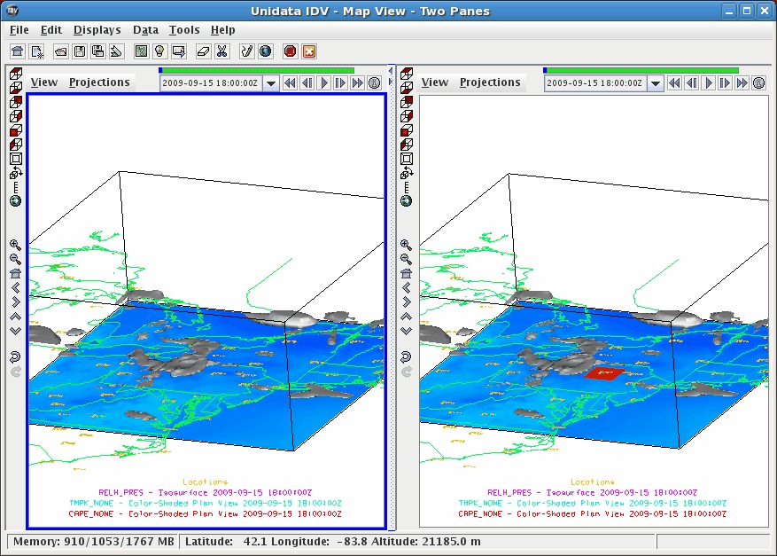
NY – Control and 335K (~144F)
Control run (left) Hot Lake (right)

Slide 13
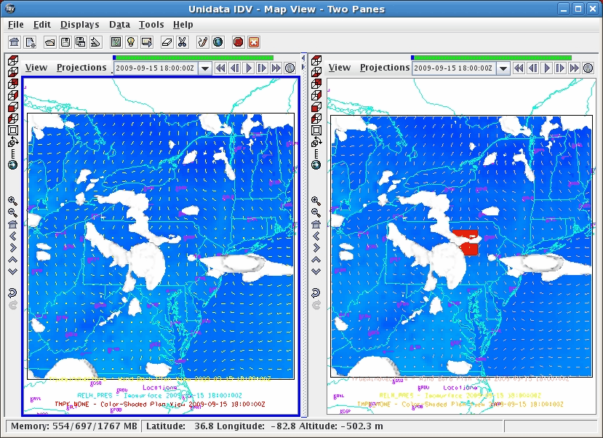
NY – Control and 345K (~160F)
Control run (left) Hot Lake (right)

Slide 14
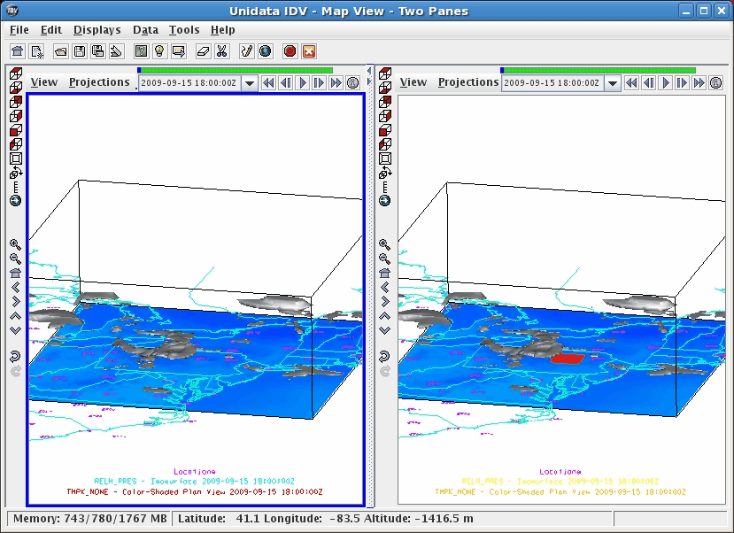
NY – Control and 345K (~160F)
Control run (left) Hot Lake (right)

Slide 15
In Progress
Still working on refining the hot lake injector
Possible issue with lake in terrain?
Ground flow may be occuring?
Working on throttling method.
Plans for systematic testing of resolution and lake size.
Integration with archive data is in progress

